Slide 1



ONLINE TRANSICTION FRAUD DETECTION SYSTEM USING PYTHON AND MACHINE LEARNING MODEL
Submitted to:-
Group members :- Atul Kawre , Himanshu Kharole, Pragya Rahangdale, Sanjana Kushwaha, Yash Verma
Group-03, batch-B

Slide 2
TABLE OF CONTENTS
Abstract
Introduction
Objective
Problem statement
Dataset
Methodology
Technologies used
Result
Future scope
Conclusion
Acknowledgment
References
Q&A

Slide 3
ABSTRACT
With the rapid growth of online transactions the risk of fraudulent activities has also increased significantly .
Billions of dollars of loss are caused every year by fraudulent online transactions. The design of efficient fraud detection algorithms is key for reducing these losses, and more and more algorithms rely on advanced machine learning techniques to assist fraud investigators.
This project proposes the development of an online transaction fraud detection system using python and machine learning(ML) techniques.

Slide 4
INTRODUCTION
Online transactions have become an integral part of modern-day commerce ,but they are susceptible to fraud .this project proposes the development of a robust fraud detection system using machine learning algorithms to identify and prevent fraudulent transaction in real-time .
Traditional rule-based systems often fail to adapt to evolving fraud patterns , thus necessitating the use of more advanced techniques like machine learning.

Slide 5
OBJECTIVES
The objectives of an online transaction fraud detection system using python and machine learning includes:-
Detection Accuracy:- Develop a system with high accuracy in identifying fraudulent transaction while minimizing false positives to avoid inconveniencing legitimate users.
Real-time Detection:- Enable the system to analyse and detect fraudulent activities in real-time to prevent financial losses and protect user’s sensitive information.
Scalability:- Ensure the system’s capability to handle large volumes of transaction data efficiently, scaling with the growth of online transactions.

Slide 6
Adaptability:- Build a system that can adapt to evolving fraud patterns and techniques by continuously learning from new data and updating its detection algorithms.
User Experience :- Maintain a seamless user experience by accurately detecting fraud without causing unnecessary disruptions or delays in legitimate transactions.
Transparency:- Provide insights into the detection process, including explanations of why certain transactions are flagged as fraudulent, to build trust with users and stakeholders.

Slide 7
PROBLEM STATEMENT
The problem statement for online transaction fraud detection system using python and machine learning would typically involve identifying fraudulent activities in online transaction to prevent financial losses .
Online transaction fraud stands as major problem for word wide financial institutions. Annual lost due to it scales to billions of dollars.

Slide 8
DATASET
We used a dataset containing various features related to online transactions, including transaction amount , location , time, etc.
The dataset consists of both fraudulent and legitimate transactions, providing a balanced view for training our model

Slide 9
METHODOLOGY
The methodologies of an online transaction detection system using python and machine learning includes –
Data preprocessing:- handling missing values , outliers, and categorical data. Scaling numerical features. Encoding categorical variables.
Feature engineering:- creating new features based on domain knowledge. Dimensionality reduction techniques like PCA for feature selection.
Model selection and training:- Experimenting with various ML algorithms such as logistic regression , random forest, gradient boosting, etc.

Slide 10
Evaluating models using metrics like accuracy, precision ,recall , and F1-score.
Model Evaluation:- Using cross- validation to ensure the model’s robustness. Analysing confusion matrix and ROC curves to assess performance.
Real –time Detection :- Integrating the trained model into a real- time system for detecting fraud during online transactions. Providing feedback mechanism to continuously improve the model’s accuracy.

Slide 11
TECHNOLOGIES USED
Technologies used of an online transaction fraud detection system using python and machine learning includes:-
Python :- Primary programming language for implementing the system logic and ML algorithms.
Scikit-learn :- python library for machine learning tasks such as data preprocessing , model training , and evaluation.
Pandas and NumPy:- Data manipulation and numerical computation libraries for handling and processing transaction data.
Flask:- Micro web framework for building the user interface and deploying the fraud detection system.

Slide 12
LIBRARY
NUMPY
PANDAS
SCIKIT-LEARN
ALGORITHM
LOGISTIC REGRESSION
DECISION TREES
RANDOM FOREST

Slide 13
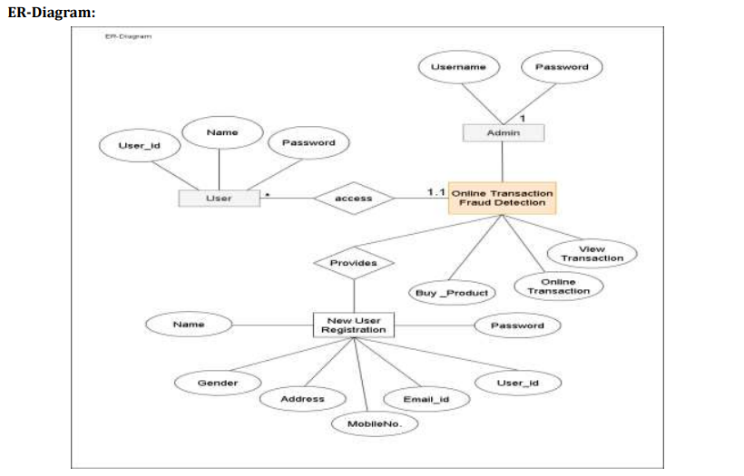

Slide 14
RESULT
Our model achieved high accuracy in detecting fraudulent transactions, with minimal false positives.
Real –time implementation demonstrated its effectiveness in identifying and preventing fraudulent activities.
Continuous monitoring and updates will further enhance the system’s performance and adaptability.

Slide 15
FUTURE SCOPE
Integration with financial institutions and online payment gateways for widespread adoption.
Exploring advanced ML techniques such as deep learning for improved accuracy.
Enhancing the user interface for better user experience and feedback mechanism.

Slide 16
CONCLUSION
In conclusion ,the proposed online transaction fraud detection system demonstrates the effectiveness of using python and machine learning techniques to combat fraudulent activities in the realm of online transactions. Continuous research and development in this field are vital to stay ahead of sophisticated fraudsters and safeguard the integrity of digital transactions.

Slide 17
ACKNOWLEDGMENT
We would like to express our sincere gratitude to all those who have contributed to the successful completion of this project on “Online transaction fraud detection system using python and machine learning”.
First and foremost , we would like to thank our teacher ,for their guidance ,valuable insights , and continuous support throughout the duration of this project. Their expertise and encouragement have been instrumental in shaping our approach and refining our methodologies.

Slide 18
REFERENCES
https://www.geeksforgeeks.org/online-payment-fraud-detection-using-machine-learning-in-python/
https://nevonprojects.com/online-transaction-fraud-detection-using-python-backlogging-on-e-commerce/
https://www.slideshare.net/irjetjournal/online-transaction-fraud-detection-system-based-on-machine-learning

Slide 19
THANK YOU

